Slide 1
Divide and Conquer
STRATEGY – 2 : Unit 2

Slide 2
Divide and Conquer – The IDEA
Divide and Conquer is one of the most well – known algorithm design strategies.
The principle underlying Divide and Conquer strategy can be stated as follows:
Divide the given instance of the problem into two or more smaller instances.
Solve the smaller instances recursively.
Combine the solutions of the smaller instances and obtain the solution for the original instance.

Slide 3
Divide and Conquer – The IDEA
An instance of size n
Sub - problem 1
of size n/2
Sub – problem 2
of size n/2
Solution to
Sub – problem 1
Solution to
Sub – problem 2
Solution to the original problem

Slide 4
General Divide and Conquer Recurrence
In the most typical cases of Divide and Conquer, a problem’s instance of size n can be divided into b instances of size n/b, with a of them needing to be solved.
Here a and b are constants; a >= 1 and b >= 1.
Assuming that size n is a power of b, we get the following recurrence for the running time:
f(n) is a function that accounts for the time spent on dividing the problem and combining the solutions.
T(n) = a * T(n/b) + f(n)

Slide 5
Master Theorem
For the recurrence:
T(n) = a * T(n/b) + f(n)
If f(n) ∈ Θ(n^{d}), where d >= 0 in the recurrence relation, then:
Analogous results hold for O and Ω as well!
If a < b^{d}, T(n) ∈ Θ(n^{d})
If a = b^{d}, T(n) ∈ Θ(n^{d} log n)
If a > b^{d}, T(n) ∈ Θ(n^{log b a} )

Slide 6
Binary Search

Slide 7
Binary Search - IDEA
Binary Search is a remarkably efficient algorithm for searching in a sorted array.
It works by comparing the search key K with the array’s middle element A[m].
If they match, the algorithm stops.
Otherwise, the same operation is repeated recursively for the first half of the array if K < A[m] and for the second half if K > A[m].
K
A[0] … A[m-2] A[m] A[m+1] … A[n-1]
Search here if K < A[m]
Search here if K < A[m]

Slide 8
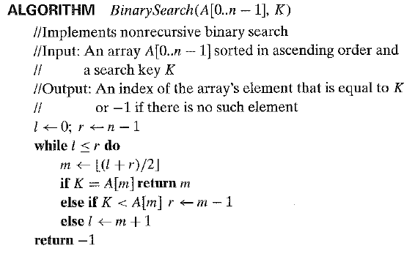
Binary Search - Algorithm

Slide 9
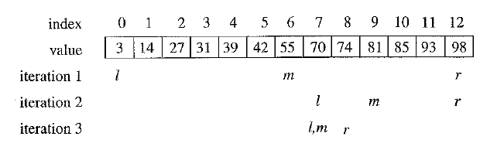
Binary Search - Example
Search Key K = 70

Slide 10
Binary Search Vs Linear Search

Slide 11


Binary Search – Analysis: WORST CASE
The basic operation is the comparison of the search key with an element of the array.
The number of comparisons made are given by the following recurrence:
For the initial condition C_{worst}(1) = 1, we obtain:
For any arbitrary positive integer, n:

Slide 12

Binary Search – Analysis: AVERAGE CASE

Slide 13
Merge Sort

Slide 14
Merge Sort - IDEA
Split array A[0..n-1] into about equal halves and make copies of each half in arrays B and C
Sort arrays B and C recursively
Merge sorted arrays B and C into array A as follows:
Repeat the following until no elements remain in one of the arrays:
compare the first elements in the remaining unprocessed portions of the arrays
copy the smaller of the two into A, while incrementing the index indicating the unprocessed portion of that array
Once all elements in one of the arrays are processed, copy the remaining unprocessed elements from the other array into A.

Slide 15
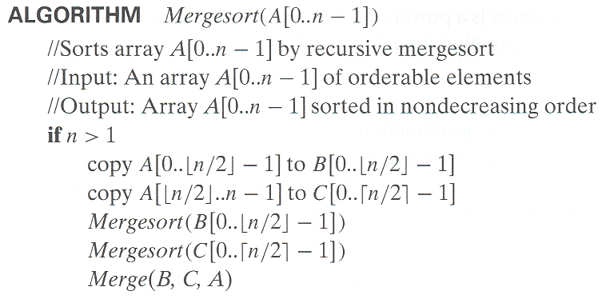
Merge Sort - Algorithm

Slide 16
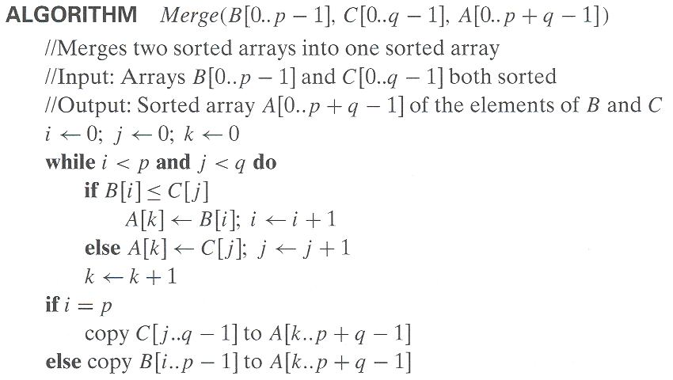
Merge Sort - Algorithm

Slide 17
Merge Sort - Example

Slide 18
Merge Sort - Analysis
Assuming for simplicity that n is a power of 2, the recurrence relation for the number of key comparisons C(n) is:
C(n) = 2C(n/2) + C_{merge}(n) [for n > 1], C(1) = 0
The number of key comparisons performed during the merging stage in the worst case is:
C_{merge}(n) = n – 1
Using the above equation:
C_{worst}(n) = 2C_{worst}(n/2) + n – 1 [for n > 1], C_{worst}(1) = 0
Applying Master Theorem to the above equation:
C_{worst}(n) ∈ Θ(n log n)

Slide 19
Quick Sort

Slide 20
Quick Sort - IDEA
Select a pivot (partitioning element) – here, the first element
Rearrange the list so that all the elements in the first s positions are smaller than or equal to the pivot and all the elements in the remaining n-s positions are larger than or equal to the pivot (see next slide for an algorithm)
Exchange the pivot with the last element in the first (i.e., ≤) subarray — the pivot is now in its final position
Sort the two subarrays recursively
p
A[i]≤p
A[i]≥p

Slide 21
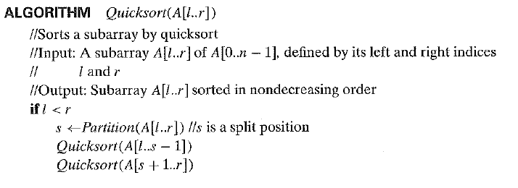
Quick Sort - Algorithm

Slide 22
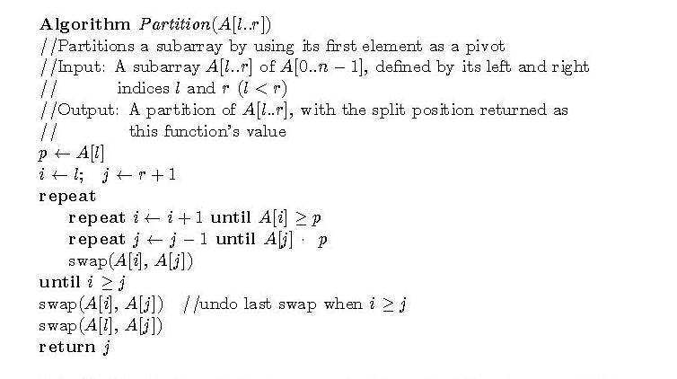
Quick Sort - Algorithm

Slide 23
Quick Sort - Example
5 3 1 9 8 2 4 7
2 3 1 4 5 8 9 7
1 2 3 4 5 7 8 9
1 2 3 4 5 7 8 9
1 2 3 4 5 7 8 9
1 2 3 4 5 7 8 9

Slide 24


Quick Sort – Analysis: BEST CASE
The number of comparisons in the best case satisfies the recurrence:
According to Master Theorem,

Slide 25

Quick Sort – Analysis: WORST CASE
The number of comparisons in the best case satisfies the recurrence:

Slide 26
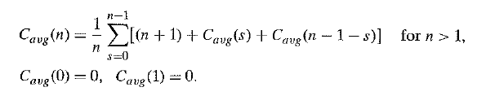

Quick Sort – Analysis: AVERAGE CASE
Let C_{avg}(n) be the number of key comparisons made by Quick Sort on a randomly ordered array of size n.
The solution for the above recurrence is:

Slide 27
Multiplication of Large Integers

Slide 28
Multiplication of large integers - IDEA
Let the two numbers being multiplied be a and b.
a and b are n – digit integers, where n is a positive even number.
Let the first half of a’s digits be a₁ and second half be a₀.
Similarly, let the first half of b’s digits be b₁ and second half be b₀.
In these notations, a = a₁a₀ implies a = a₁*10^{n/2} + a₀ and b = b₁b₀ implies b = b₁*10^{n/2} + b⁰.

Slide 29
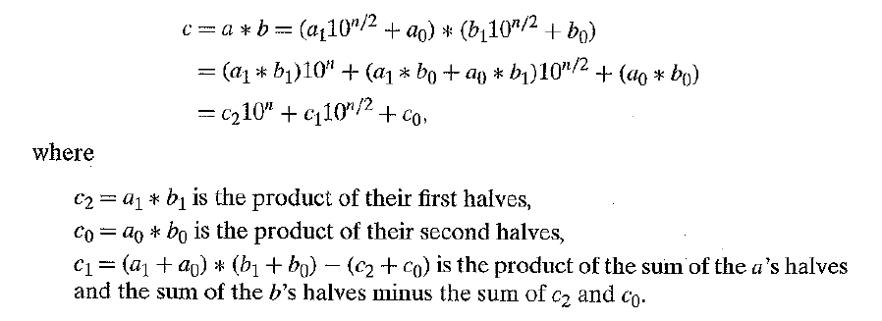
Multiplication of large integers - IDEA

Slide 30
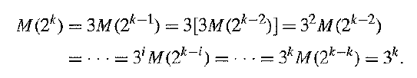
Multiplication of large integers - Analysis
M(n) = 3M(n/2) for n > 1, M(1) = 1
Solving it by backward substitutions for n = 2^{k} yields:
Since k = log₂n: M(n) = 3^{log}2^{n} = n^{log}2³ = n^{1.585}
The number of additions is given by:
A(n) = 3A(n/2) + cn for n > 1, A(1) = 1
A(n) belongs to Θ(n^{log23})

Slide 31
Example
2135 * 4014
= (21*10² + 35) * (40*10² + 14)
= (21*40)*10⁴ + c1*10² + 35*14
where c1 = (21+35)*(40+14) - 21*40 - 35*14, and
21*40 = (2*10 + 1) * (4*10 + 0)
= (2*4)*10² + c2*10 + 1*0
where c2 = (2+1)*(4+0) - 2*4 - 1*0, etc.

Slide 32
Strassen’s Matrix Multiplication

Slide 33
Strassen’s Matrix Multiplication
This algorithm was published by V Strassen in 1969.
The principal insight of the algorithm lies in the discovery that we can find product of two 2 – by – 2 matrices A and B with seven multiplications as opposed to the eight required by the Brute – Force algorithm.
This is accomplished by the following formulae:

Slide 34
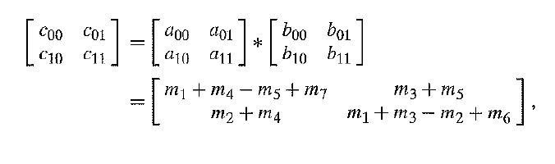
Strassen’s Matrix Multiplication

Slide 35
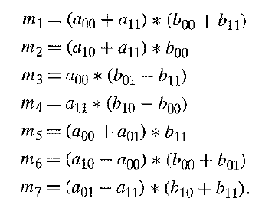
Strassen’s Matrix Multiplication

Slide 36
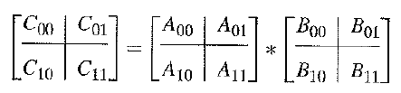
Strassen’s Matrix Multiplication – General Formula
For any two matrices A and B of size n – by – n, we can divide A, B and the product C as follows:
The sub – matrices can be treated as numbers to get the correct product.

Slide 37
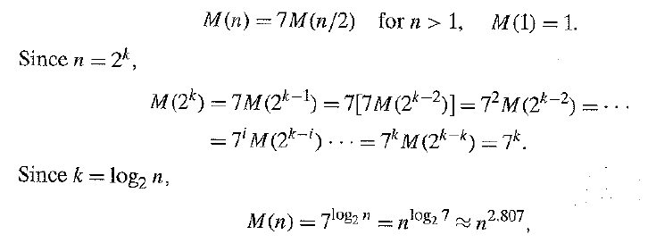
Strassen’s Matrix Multiplication – Analysis
If M(n) is the number of multiplications made by Strassen’s algorithm in multiplying two matrices n – by – n, we get the following recurrence relation for it:

Slide 38
Strassen’s Matrix Multiplication – Analysis
The number of additions are given by the following recurrence:
According to Master’s Theorem, A(n) belongs to Θ(n^{log27})

Slide 39
Binary Tree Traversals and Other Properties

Slide 40
What is a Binary Tree?
A binary tree T is defined as a finite set of nodes that is either empty or consists of a root and two disjoint binary trees T_{L} and T_{R} called as the left and right subtree of the root.
The definition itself divides the Binary Tree into two smaller structures and hence many problems concerning the binary trees can be solved using the Divide – And – Conquer technique.
The binary tree is a Divide – And – Conquer ready structure ☺

Slide 41
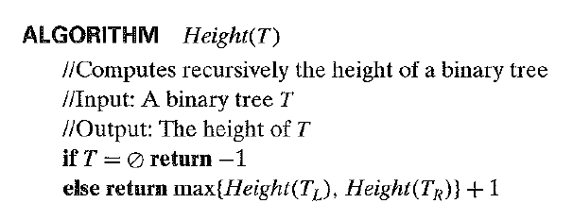
Height of a Binary Tree
Height of a binary tree = Length of the longest path from root to leaf.

Slide 42
Height of a Binary Tree – Analysis
The measure of input’s size is the number of nodes in the given binary tree. Let us represent this number as n(T).
Basic Operation: Addition
The recurrence relation is setup as follows:
A(n(T)) = A(n(TL)) + A(n(TR)) + 1, for n(T) > 0
A(0) = 0

Slide 43
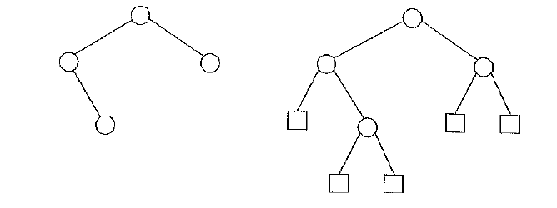
Height of a Binary Tree – Analysis
In the analysis of tree algorithms, the tree is extended by replacing empty subtrees by special nodes called external nodes.

Slide 44
Height of a Binary Tree – Analysis
x – Number of external nodes
n – Number of internal nodes
x = n + 1
The number of comparisons to check whether a tree is empty or not:
C(n) = n + x = 2n + 1
The number of additions is:
A(n) = n

Slide 45
Binary Tree Traversals
The three classic traversals for a binary tree are inorder, preorder and postorder traversals.
In the preorder traversal, the root is visited before the left and right subtrees are visited (in that order).
In the inorder traversal, the root is visited after visiting its left subtree but before visiting the right subtree.
In the postorder traversal, the root is visited after visiting the left and right subtrees (in that order).

Slide 46
Binary Tree Traversals
Algorithm Inorder(T)
if T ≠ ∅
Inorder(T_{left})
print(root of T)
Inorder(T_{right})
Algorithm Preorder(T)
if T ≠ ∅
print(root of T)
Preorder(T_{left})
Preorder(T_{right})
Algorithm Postorder(T)
if T ≠ ∅
Postorder(T_{left})
Postorder(T_{right})
print(root of T)

